Slide 1
Single-Table Queries

Slide 2
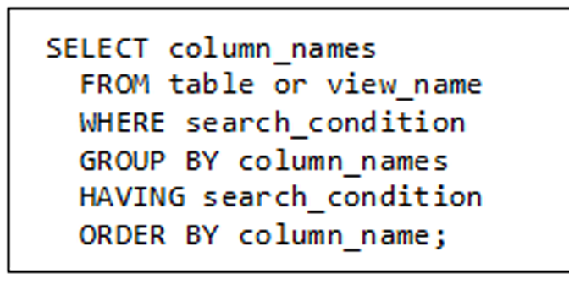
Basic Format of SELECT Statement

Slide 3
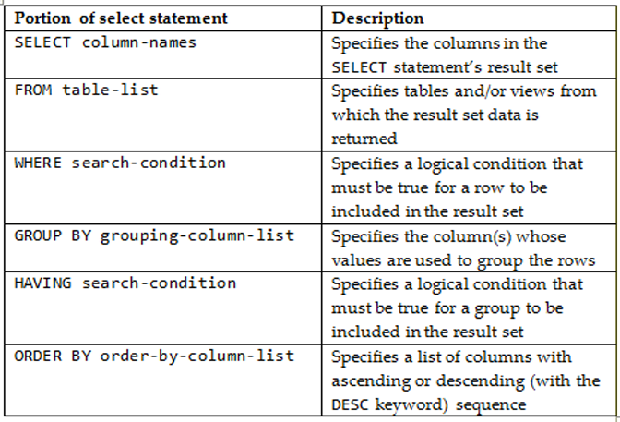
Basic Format of SELECT Statement

Slide 4
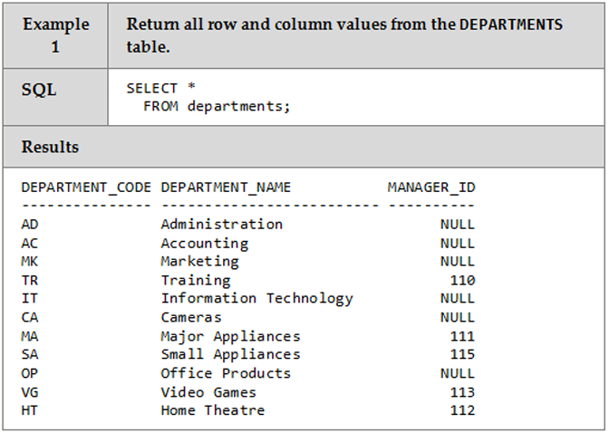
SELECT *

Slide 5
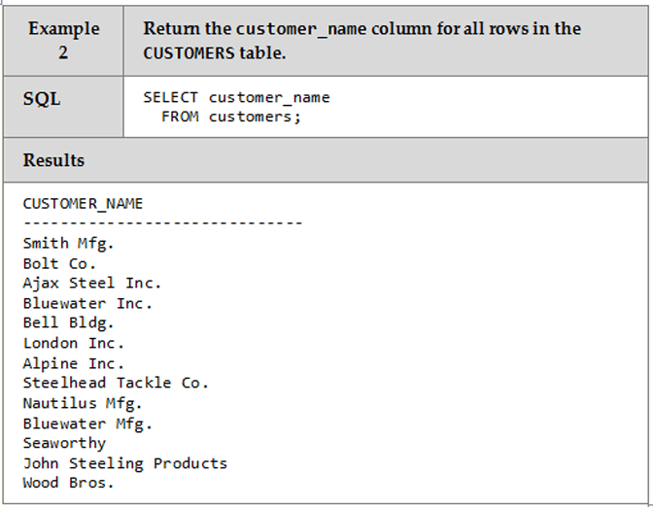
SELECT One Column From a Table

Slide 6
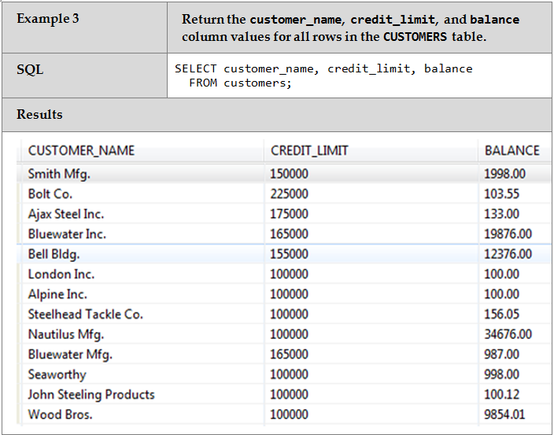
SELECT Multiple Columns From a Table

Slide 7
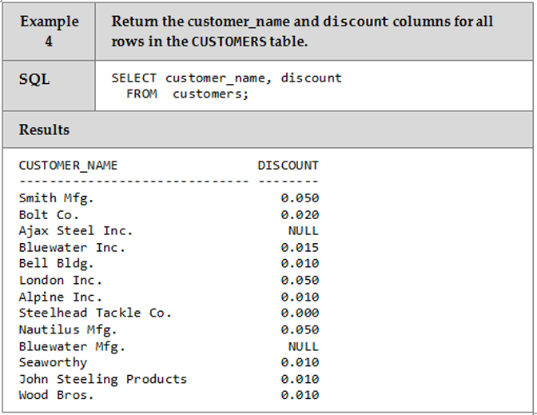
NULL Values

Slide 8
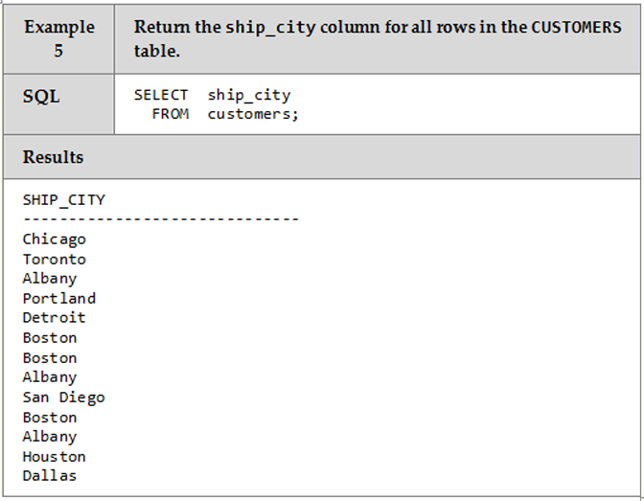
No DISTINCT Keyword

Slide 9
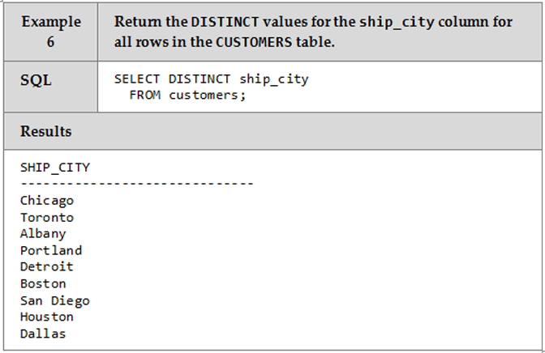
DISTINCT Keyword

Slide 10
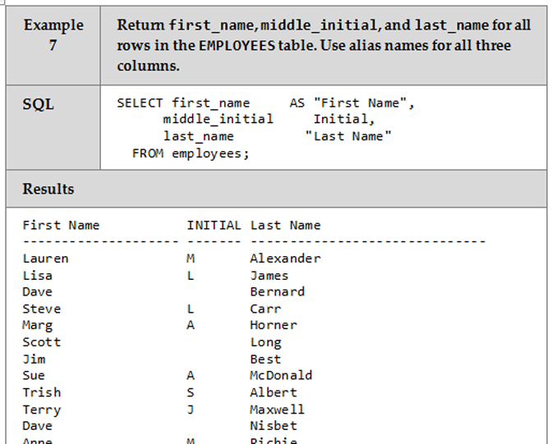
The AS (alias) Clause

Slide 11
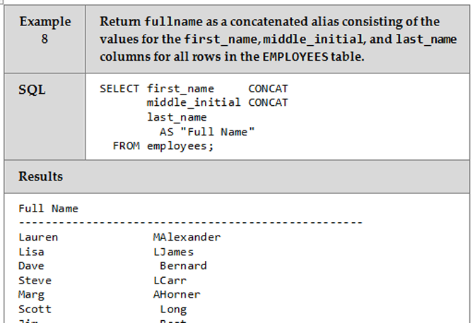
CONCAT (or ||) Operator

Slide 12
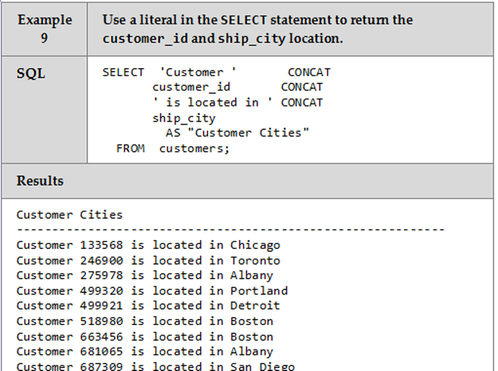
Using Literals

Slide 13
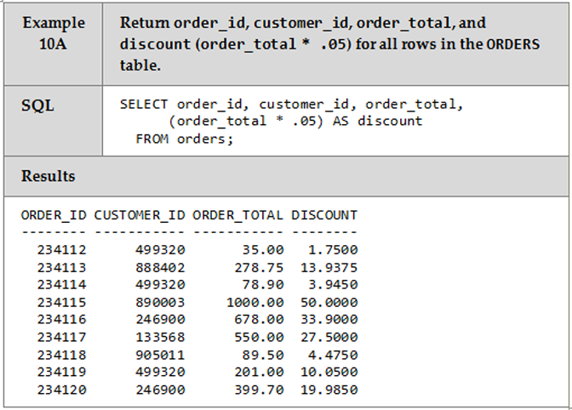
Computed Columns

Slide 14
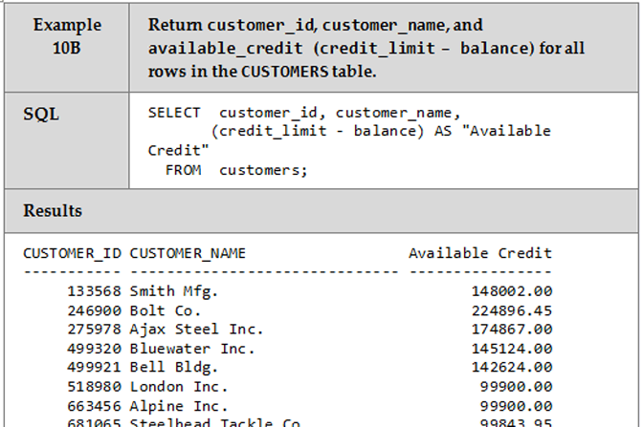
Computed Columns

Slide 15
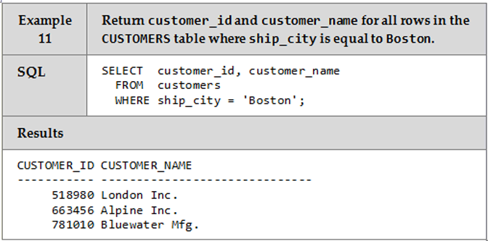
WHERE Clause – Simple Search Condition

Slide 16
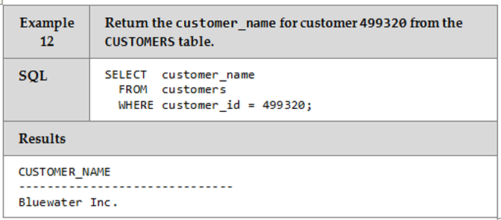
WHERE Clause with a Primary Key

Slide 17
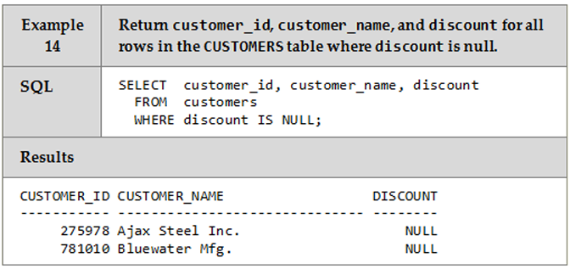
IS NULL Condition in WHERE Clause

Slide 18
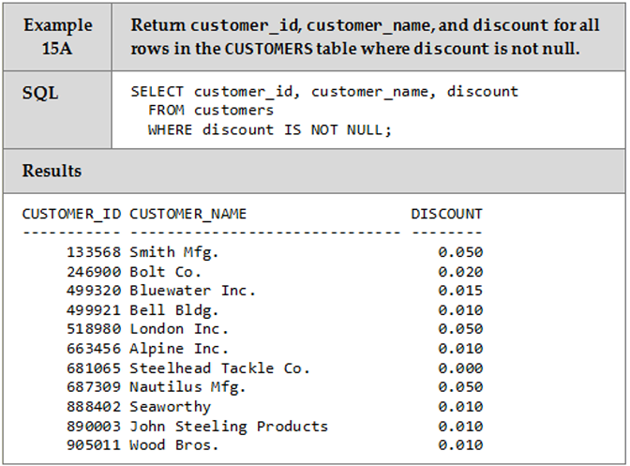
IS NOT NULL Condition in WHERE Clause

Slide 19
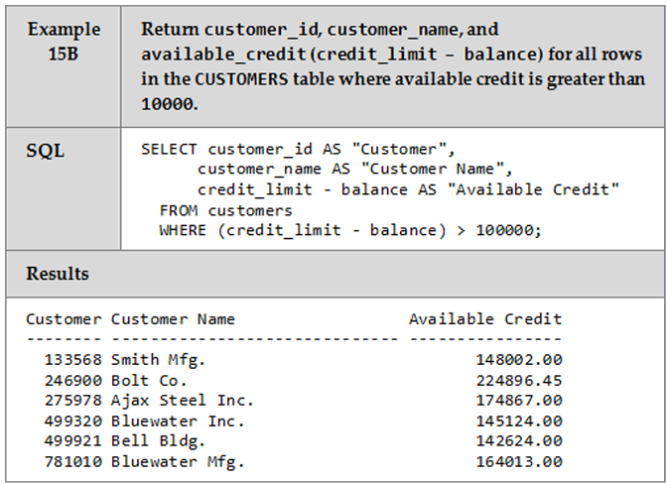
Using a Computed Value with a WHERE Clause

Slide 20
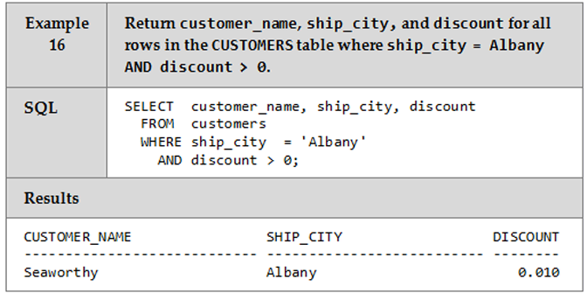
Using Compound Conditions

Slide 21
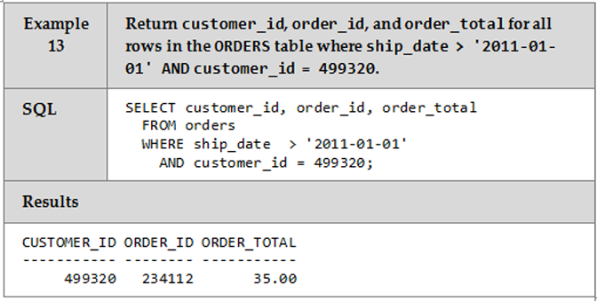
Using Compound Conditions

Slide 22
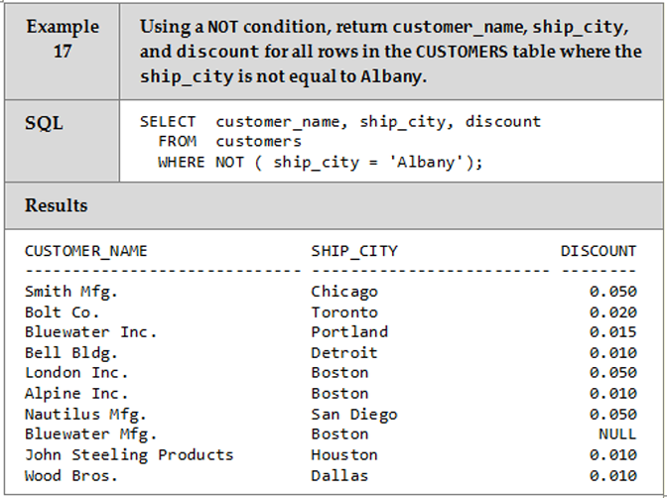
Negating a Condition

Slide 23
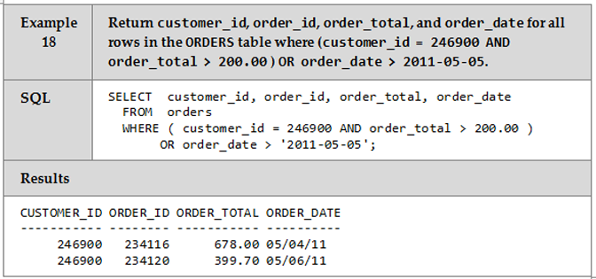
Order of Evaluation ()

Slide 24
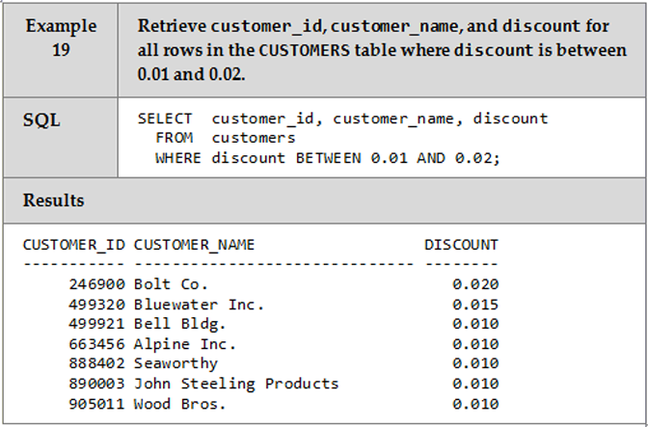
BETWEEN Operator

Slide 25
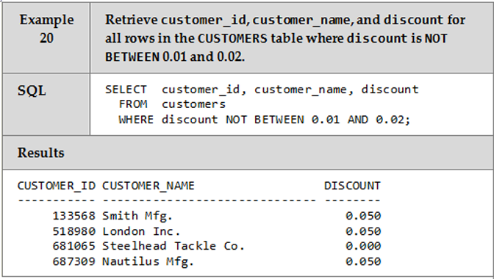
NOT Keyword with BETWEEN Operator

Slide 26
LIKE Operator
The LIKE operator permits the use of wildcards in the WHERE clause to perform string pattern matching
Two patterns can be used:
The percent sign (%) specifies a match to a string of any length (including zero length)
Underscore (_) specifies a match on a single character

Slide 27
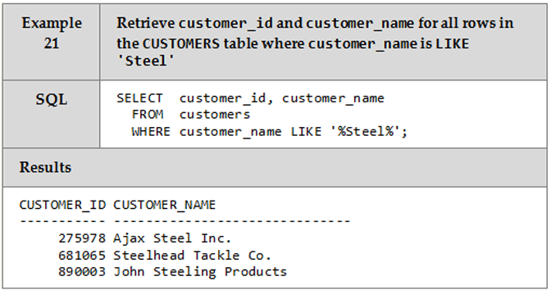
LIKE Operator

Slide 28
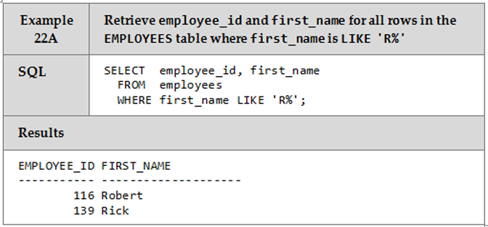
LIKE Operator

Slide 29
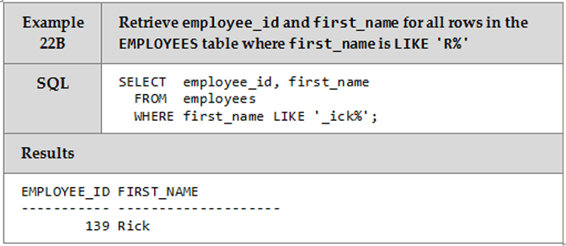
LIKE Operator

Slide 30
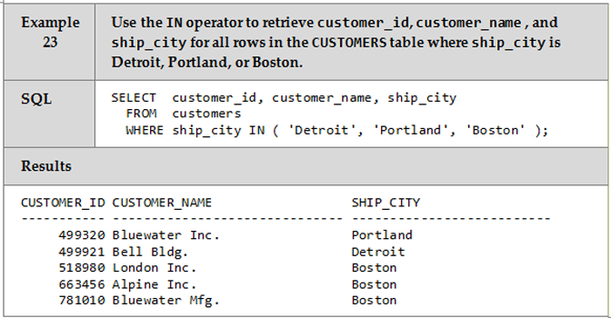
IN Operator

Slide 31
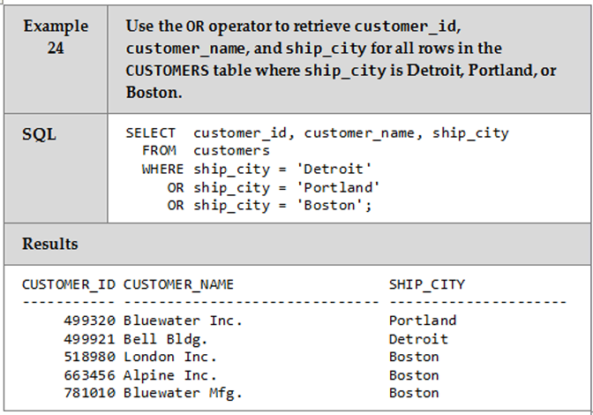
Using OR Instead of IN

Slide 32
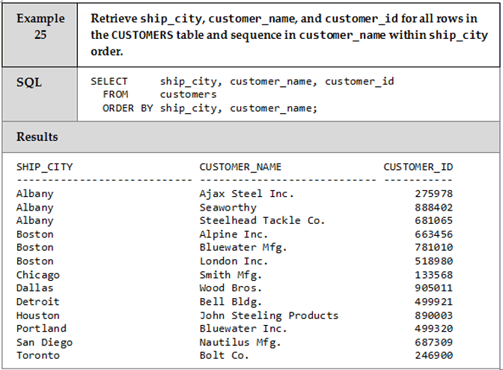
ORDER BY Clause

Slide 33
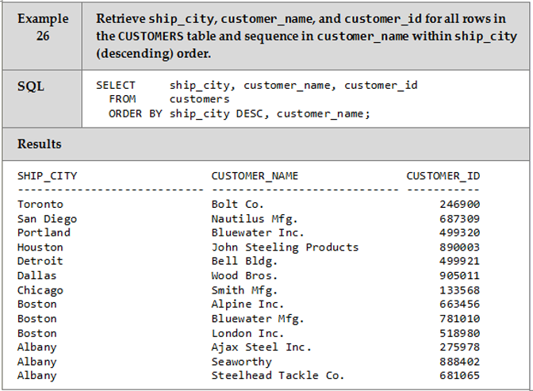
ORDER BY..DESC Clause

Slide 34
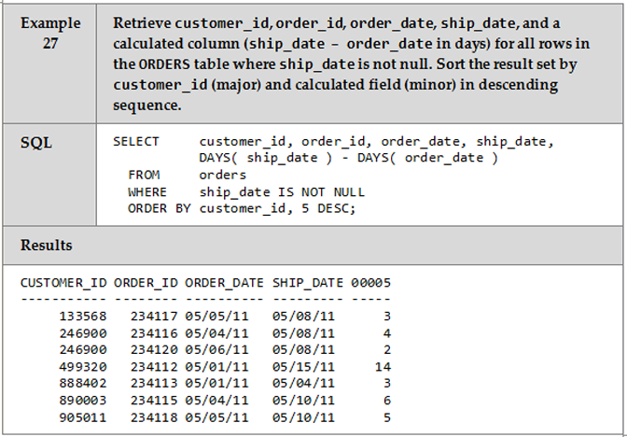
Using a ORDER BY Clause with a Relative Column Number

Slide 35
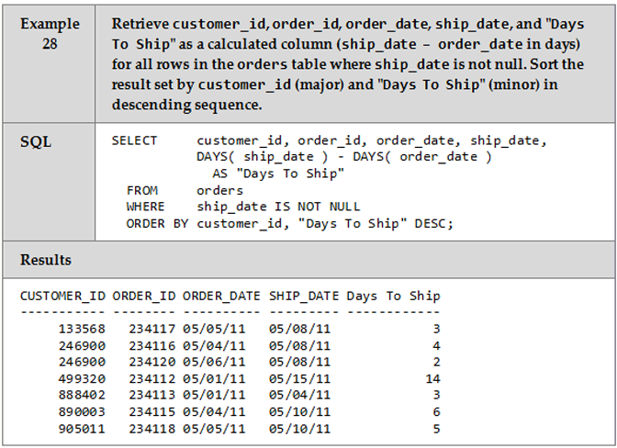
Using ORDER BY with an Alias Name assigned to a derived Column

Slide 36
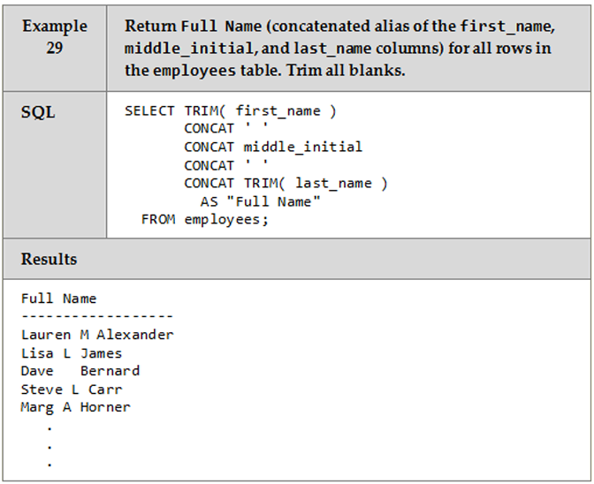
TRIM Function

Slide 37
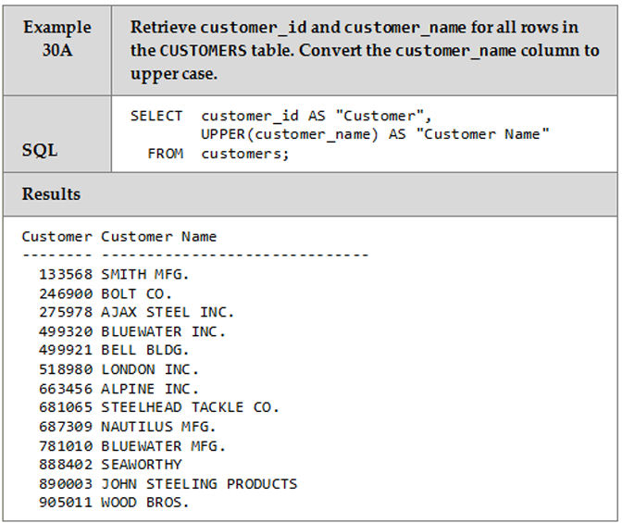
UPPER Functions

Slide 38
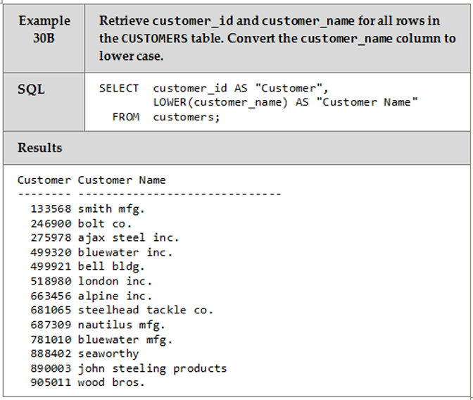
LOWER Function

Slide 39
ROUND & DECIMAL Functions
The Round function is used to round a numeric value to the number of decimals specified in the function
The DECIMAL function returns a decimal representation of a number

Slide 40
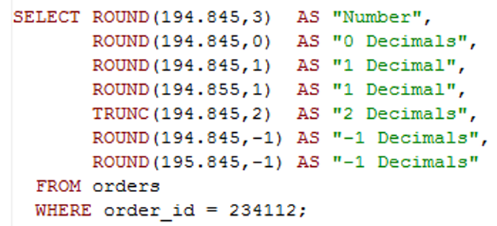
ROUND Function

Slide 41
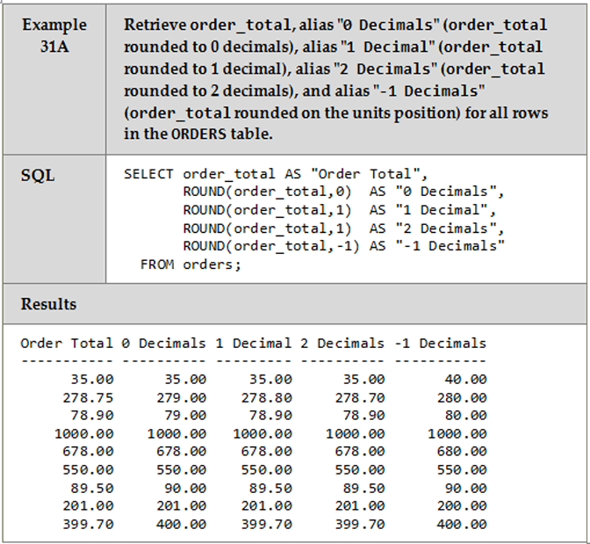
ROUND Function

Slide 42
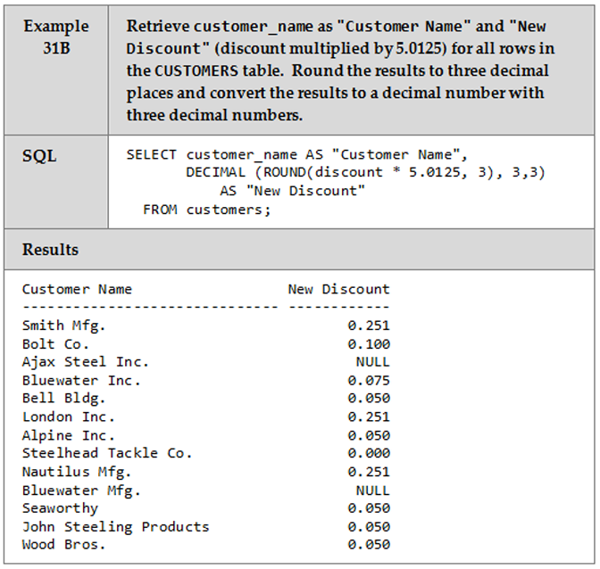
DECIMAL Function

Slide 43
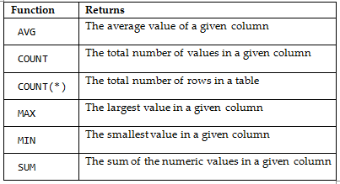
Aggregate Functions
Aggregate functions produce a value from a set of rows

Slide 44
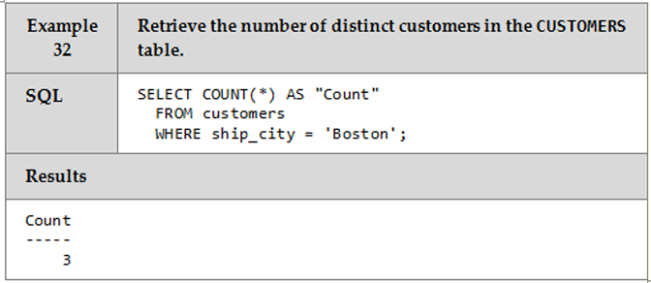
COUNT(*) Functions

Slide 45
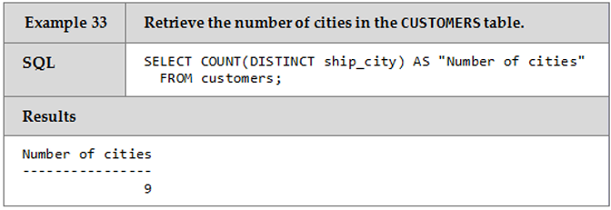
COUNT (DISTINCT)

Slide 46
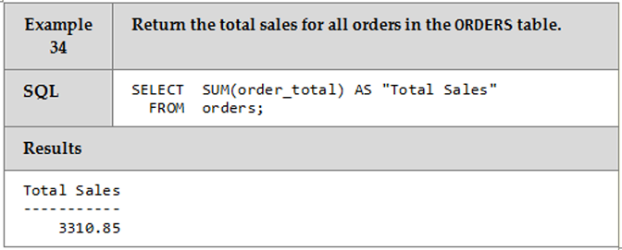
SUM Function

Slide 47
SUM Function
Read pages 178 – 181 and examples 35 – 38

Slide 48
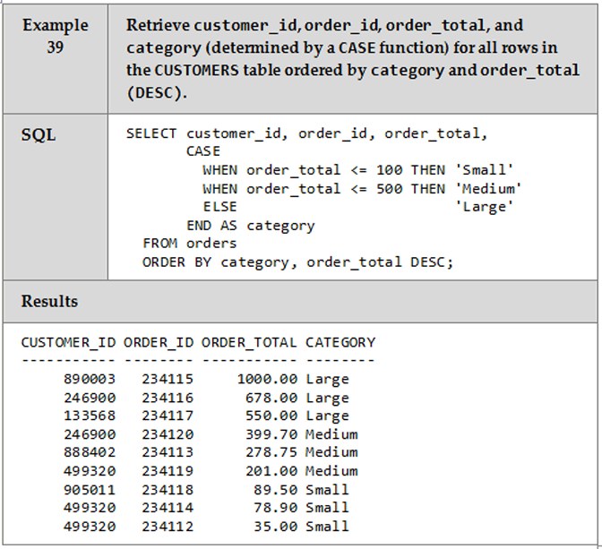
CASE Function

Slide 49
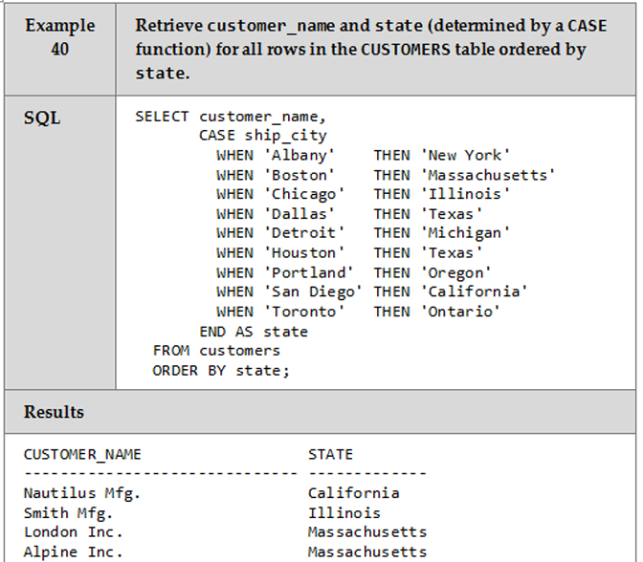
CASE Function

Slide 50
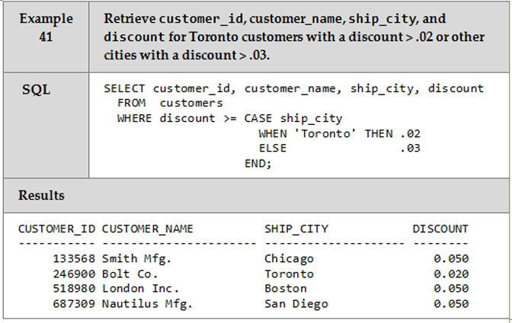
Using CASE in the WHERE Clause

Slide 51
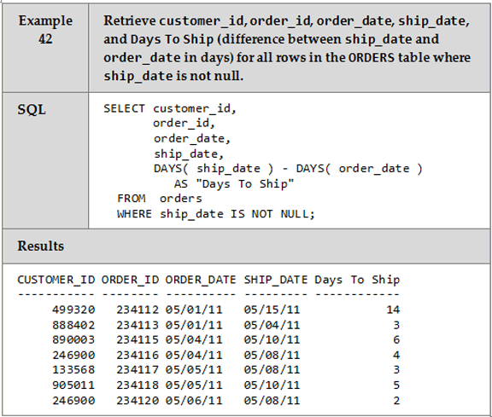
DAYS Function

Slide 52
GROUP BY and HAVING Clauses
The GROUP BY clause works with aggregate functions to group the data in the result set by columns
The HAVING clause can be used to restrict rows in the result set after aggregate functions have been applied to grouped rows

Slide 53
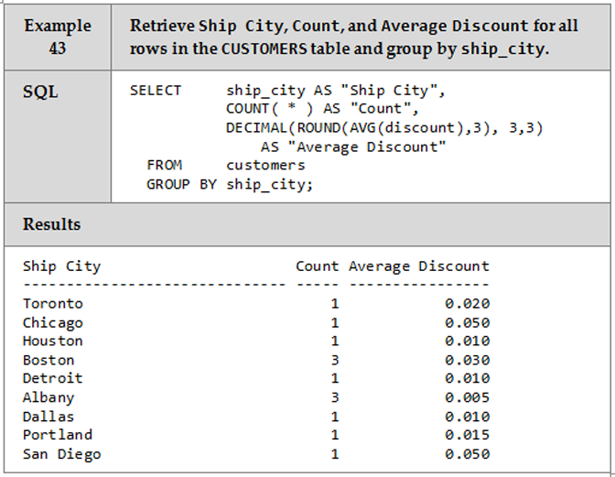
GROUP BY Clause

Slide 54
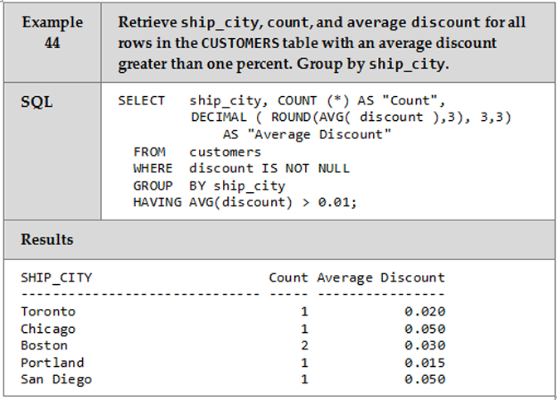
HAVING Clause

Slide 55
GROUP BY & HAVING Clauses
Read pages 187 – 191 and examine examples 45 – 47

